Slide 1

REAL LIFE LAB (RLL) PROJECT
GROUP
4
PROJECT NAME : ONLINE PHARMACY APPLICATION
Presented By :
1. Manisha Saha (2587555)
2. Lingareddy Surya Vardhan (2587353)
3. M Sriama Madusuthanan (2587776)
4. Mohammed Irshan (2587116)
5. Krithika Kumari (2586749)
6. Meghana D (2587305)
7. Mythika Kanthasami (2587518)
8. Nirmal Gupta (2587629)

Slide 2
CONTENTS
Title
Contents
Modules
Objective
Introduction
Database schema
Admin and user components
Software requirements
Online Pharmacy Application.
Testing reports
Conclusion
Thank you

Slide 3
MODULES
Name | Domain | Modules
1. Kritika Kumari | FSD User | Sign In/Sign Up and Landing Page
2. Linagareddy Surya Vardhan | FSD Admin/User | Admin/User Query
3. M Srirama Madusuthanan | FSD User | CRUD Operation for Medicines and Admin Dashboard
4. Mohammed Irshan | FSD User | User/Admin Review
5.Manisha Saha | FSD User | Admin/User Profile
6. Meghana D | FSD User | User Dashboard & Add to Cart
7. Mythika Kanthasami | FSD User | Navigation,Wishlist and Password reset
8. Nirmal Gupta | FSD Admin/User | Admin/User Order

Slide 4

OBJECTIVES
Efficient delivery and simple ordering Process
Quick Treatment with just one click
Contactless ordering
Completely Convenient and Discreet services

Slide 5
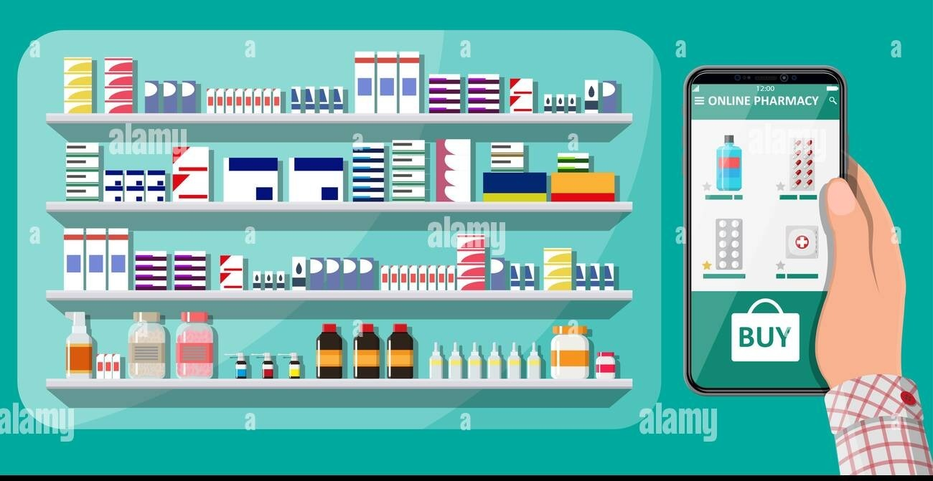
INTRODUCTION
Online Pharmacy Application has two parts
i.Admin
ii.User
The Admin Section is to display and restore the Medicines Available in the Pharmacy store,update, delete or modifiy the Customer details and also can see the order placed by the Customer, giving users to explore the Application.
Users can create personalized User credentials to login into the Application, Search the medicines, add to cart, Place the order, Make the Payment, Cancel the order, download the payment details or History.

Slide 6





Database: MySql Workbench Back-end: Spring Boot Suite Tool Front-End: Angular With VS-Code Testing: Postman Tool, Selenium Test Ng
SOFTWARE REQUIREMENTS

Slide 7

ADMIN AND USER COMPONENTS

Slide 8
ADMIN COMPONENTS
Welcome page
Admin dashboard
Admin Registration
Admin login
Reset Password
Restore Medicines
Update, delete or Modify User details
Check Order Details.

Slide 9
USER COMPONENTS
User dashboard
User register
User login
Reset Password
User profile
Search Medicines and Adding to Cart
Place order, Cancel order
Make Payment
Download the receipt

Slide 10

At welcome page we can access sign in and sign up Pages.
WELCOME PAGE

Slide 11
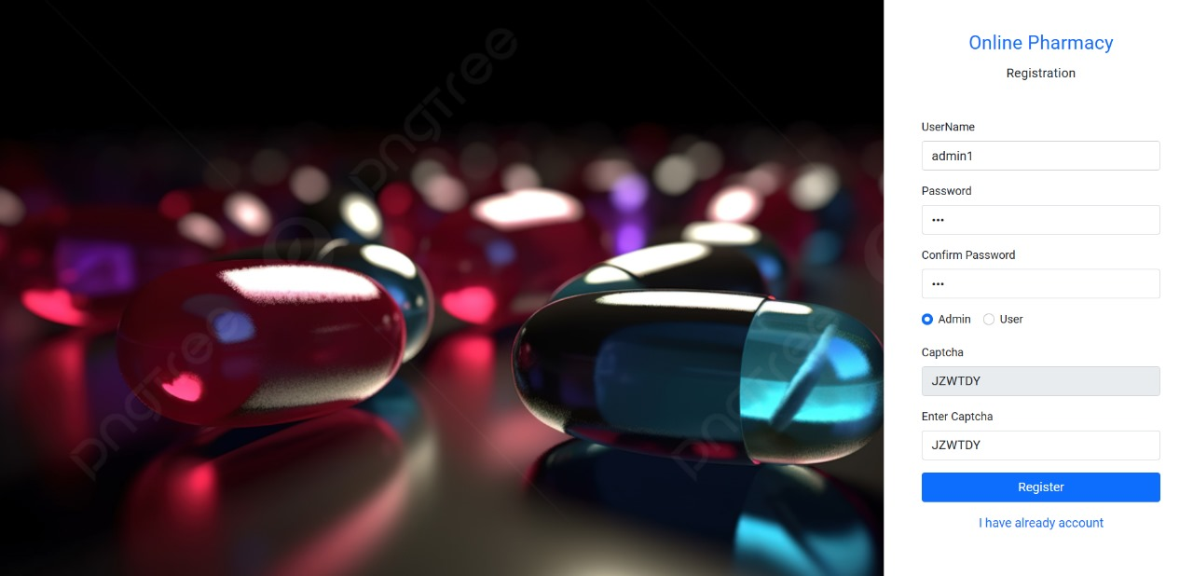
SIGN UP
In sign-up page the admin and users can able to register their profile by giving the user name and password.
If you want to enter into profile we need to create profile for admin/user.

Slide 12
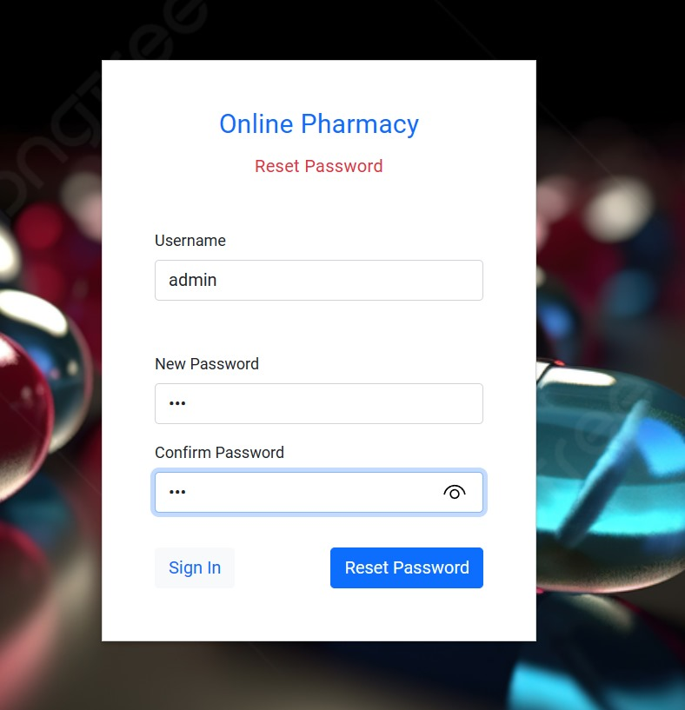
SIGN IN(Admin and user)
In this page the admin and user can able to login to their profile using their credentials.
If the credentials doesn’t match then it shows an error.

Slide 13
RESET PASSWORD
In reset password module the user and admin can reset the password by using their user name.
In Rest Page, the user & admin can give their email address for resetting password

Slide 14
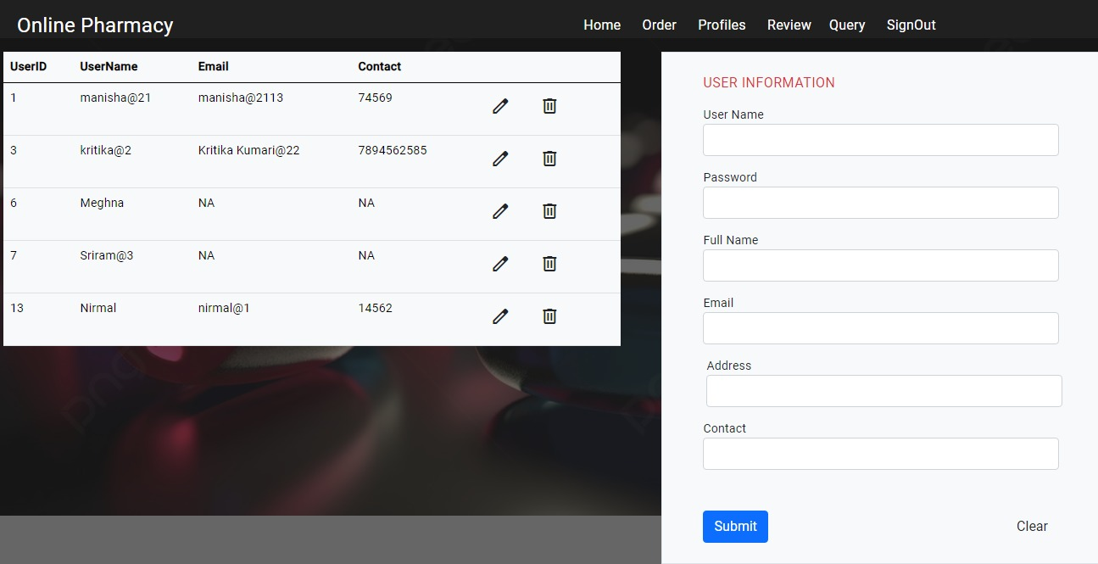
NAVIGATION PAGE

Slide 15
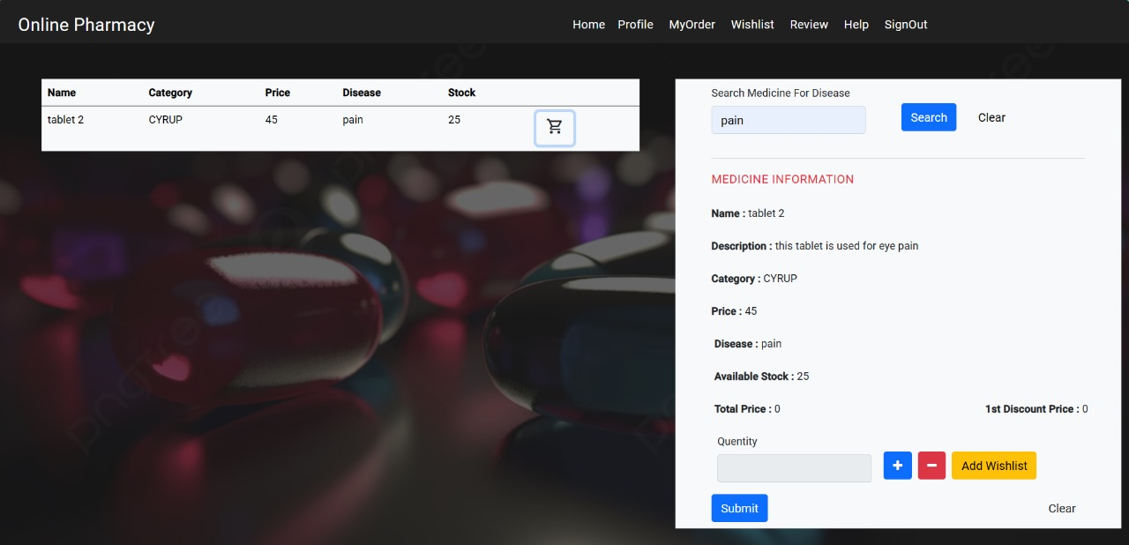
USER HOME
After Successful login by the user, the user can search the medicines in 2 ways
User can search the required medicines by using Name of the medicine
User can also search for the medicines on the basis of diseases.

Slide 16
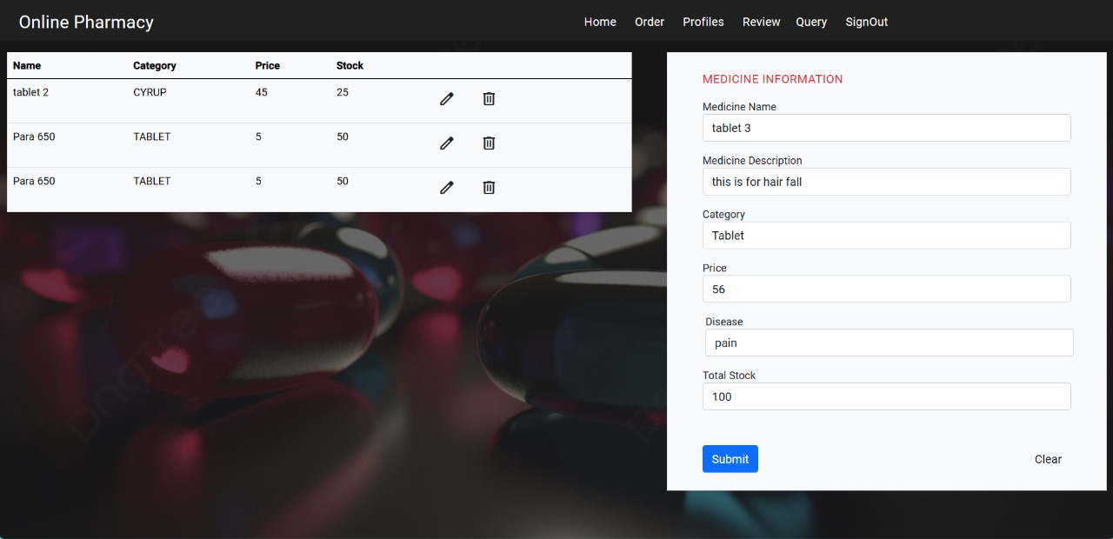
MEDICINE INFORMATION
Admin login to the application using admin credentials.
Admin is able to restore the medicines stock in Admin dashboard.

Slide 17
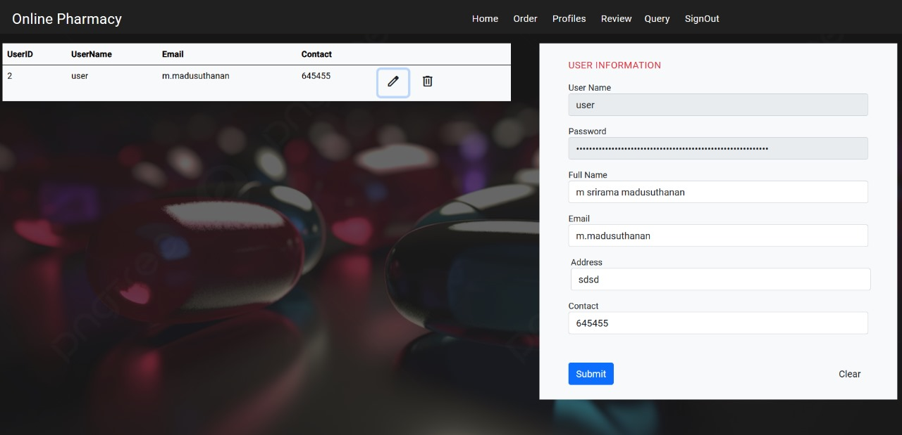
In this page admin can see all users added details and can able to add, update, and delete the user information, by leaving the username and password unaltered.
ADMIN DASHBOARD

Slide 18
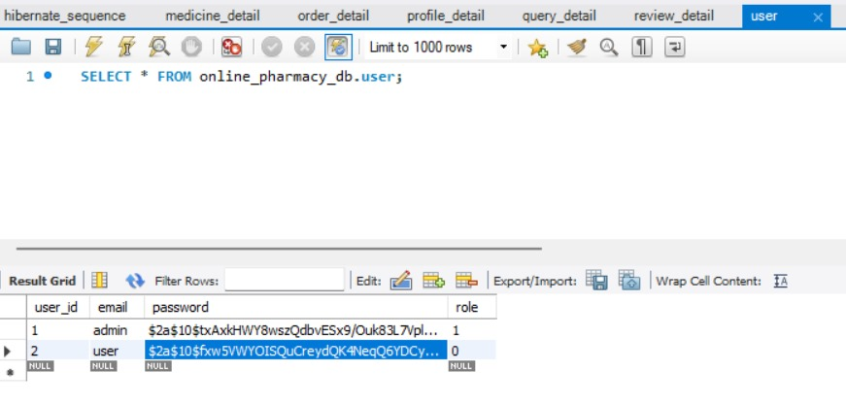
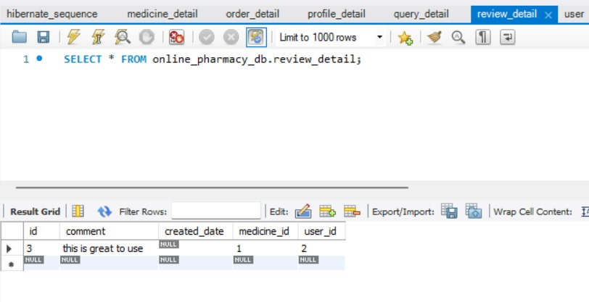
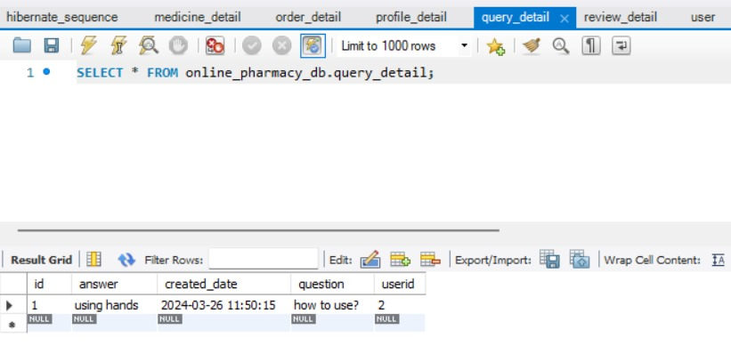
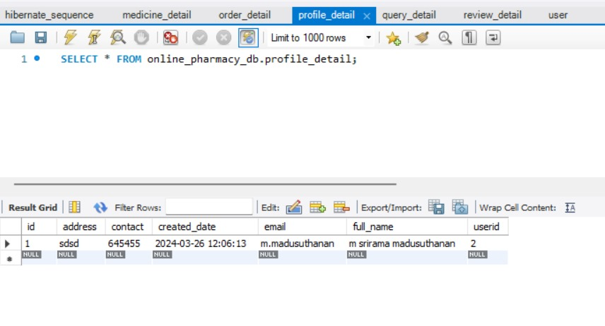
DATABASE SCHEMA
User
Review
Query Details
Profile Details

Slide 19
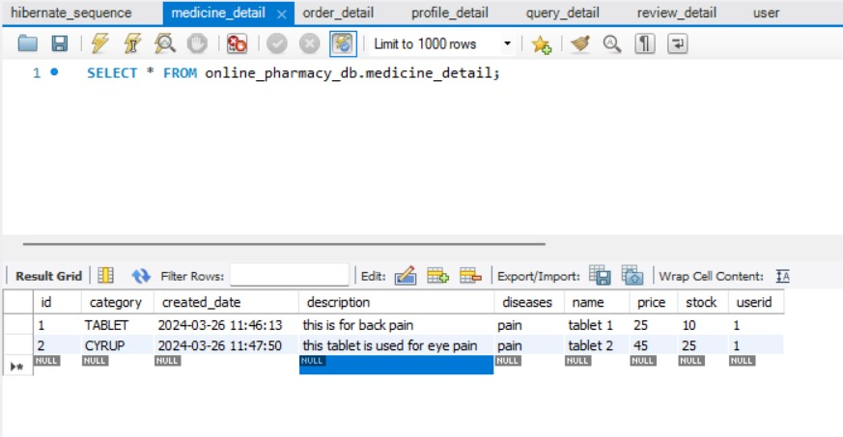
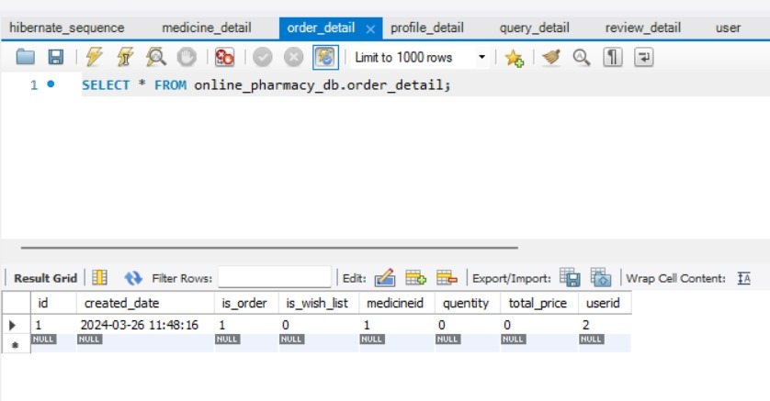
Medicines details Order details

Slide 20
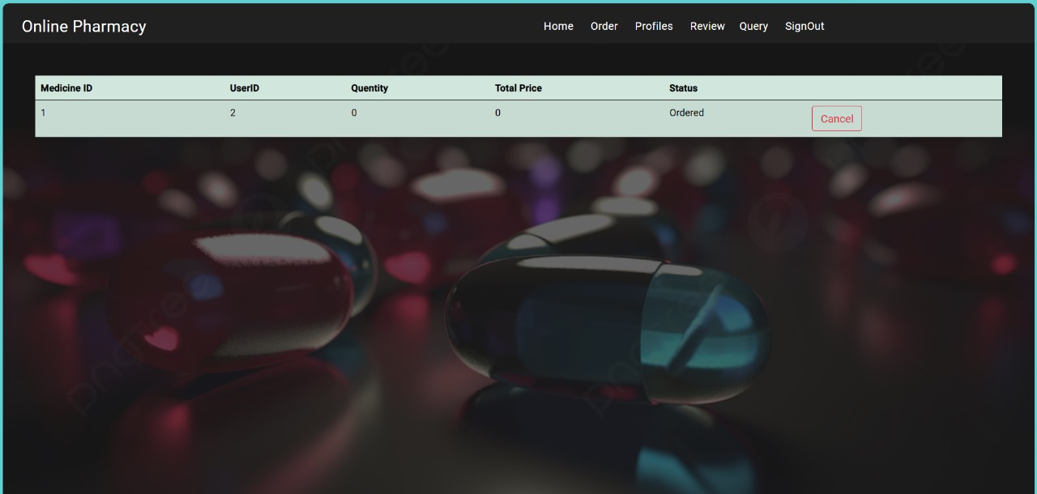
ORDER PLACEMENT BY USER
On successful User login, redirected to user homepage/Dashboard.
In that page the user can able to search the prescribed medicine, if the medicine is available, user can Place their order and also able to cancel the order.

Slide 21
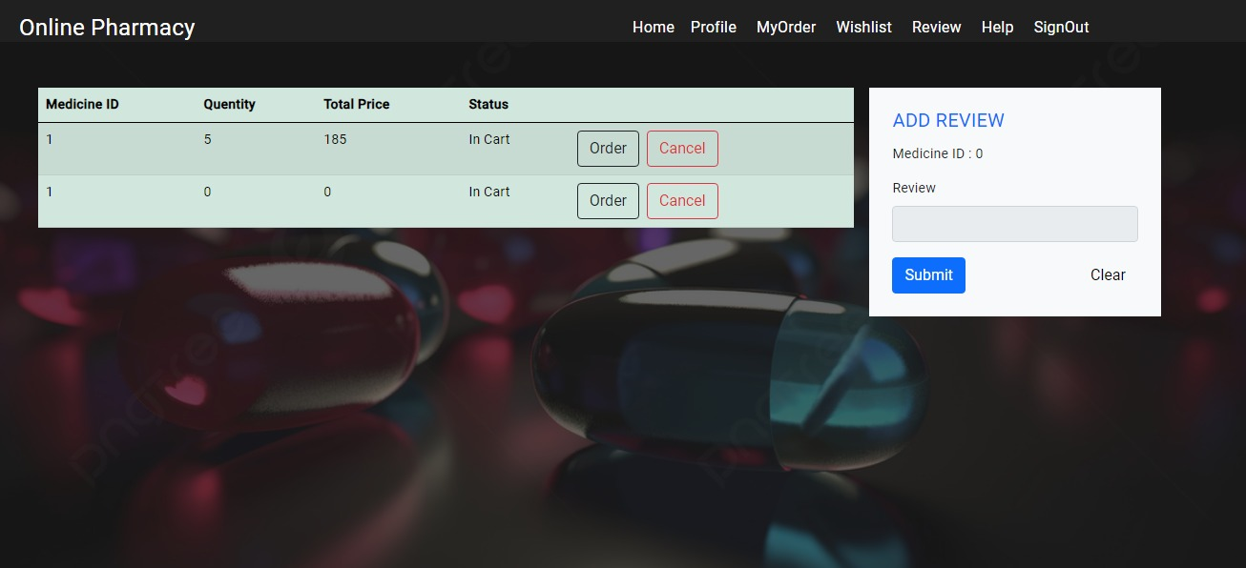
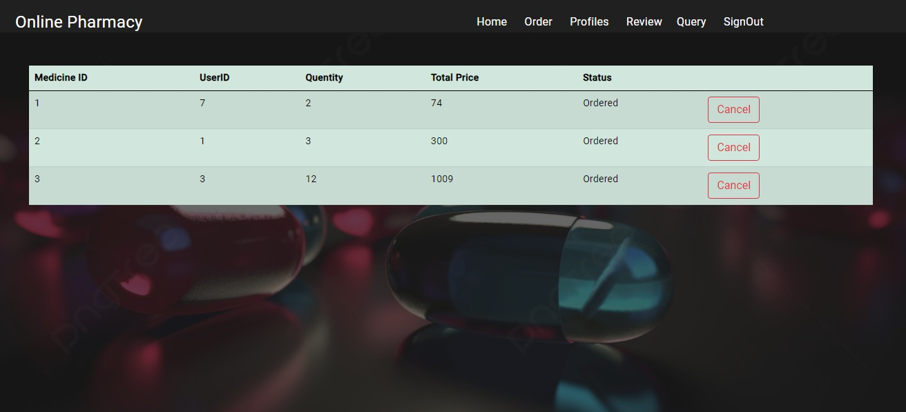
ORDER VIEW BY ADMIN

Slide 22
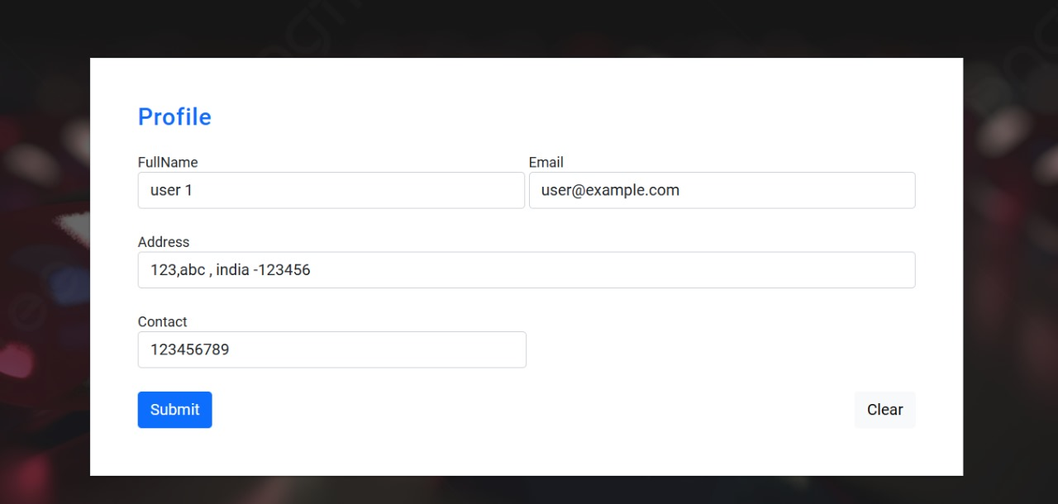
USER/ADMIN PROFILE
The User or Customer can able to create their profile details.
The User or Customer can able to able to their profile details in the application, as well as they can update their profile details.

Slide 23
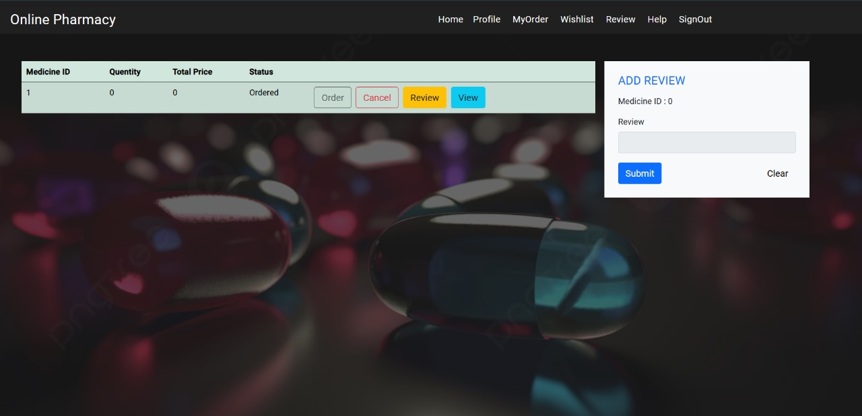
USER/ADMIN REVIEW
User or customer can add their reviews regarding the product or Medicines.
Apart from reviews user can also add their query or issues with the product they have ordered from the application.

Slide 24
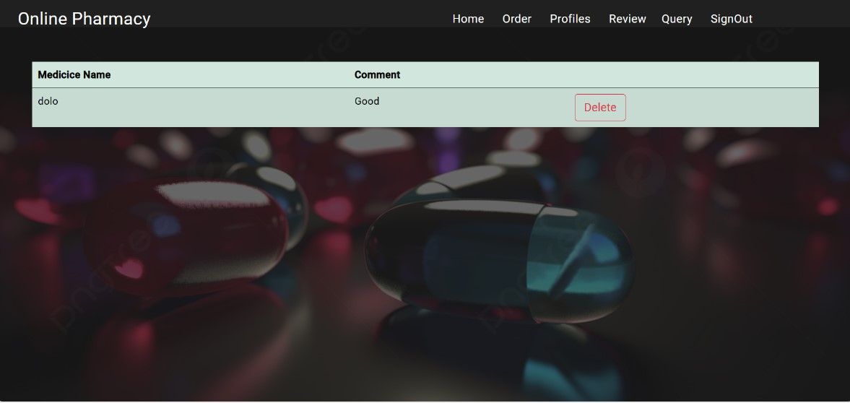

Slide 25
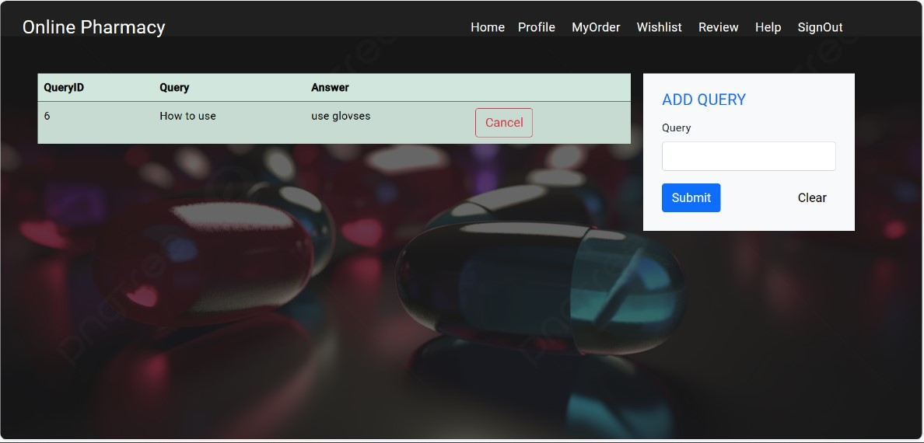
ADMIN/USER QUERY
Apart from reviews user can also add their query or issues with the product they have ordered from the application.

Slide 26
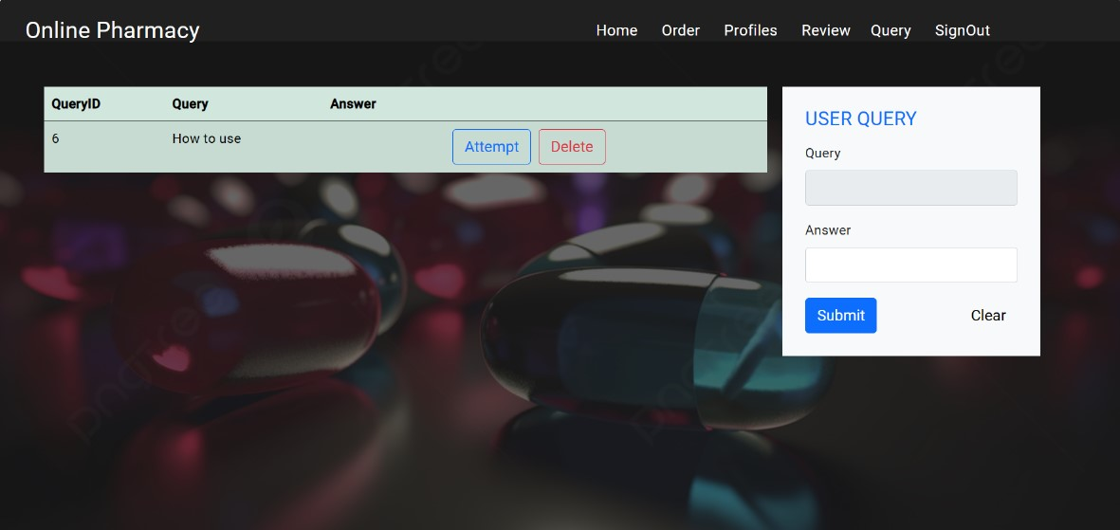

Slide 27

POSTMAN TESTING REPORTS

Slide 28
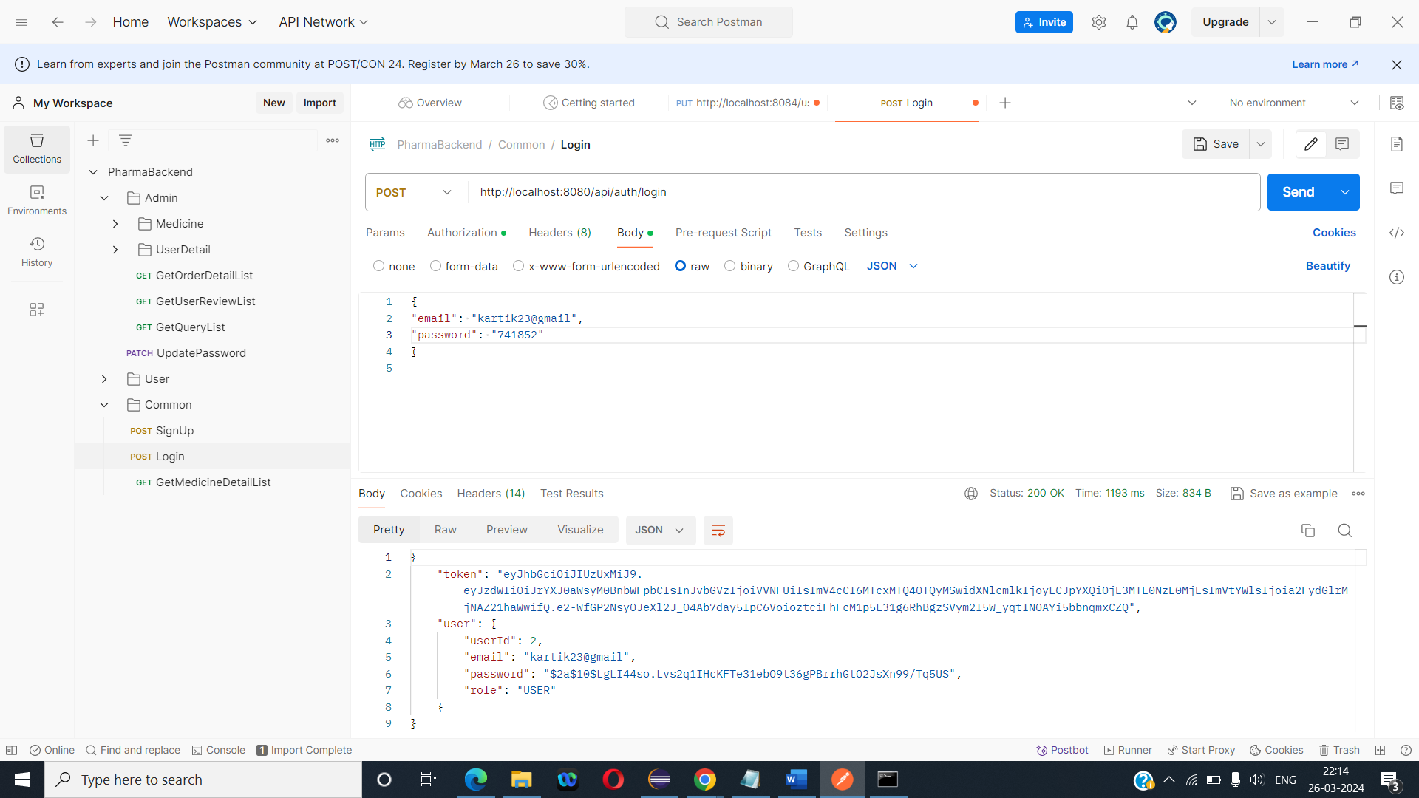

Slide 29
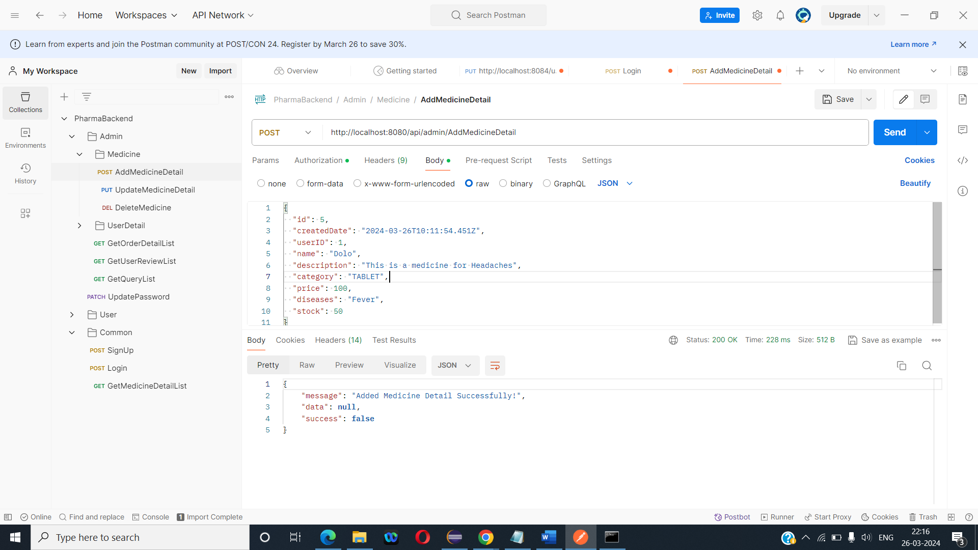

Slide 30
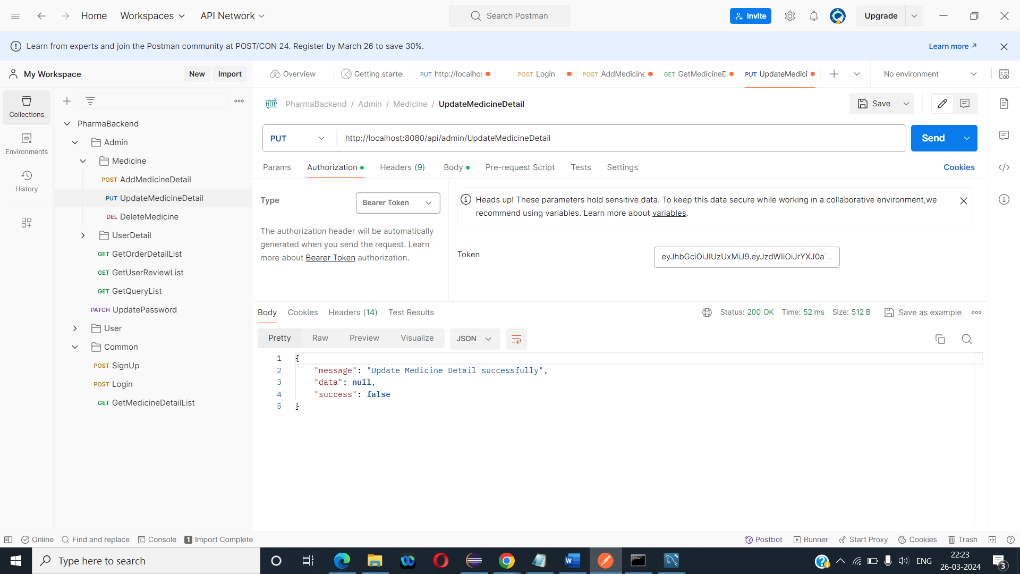

Slide 31
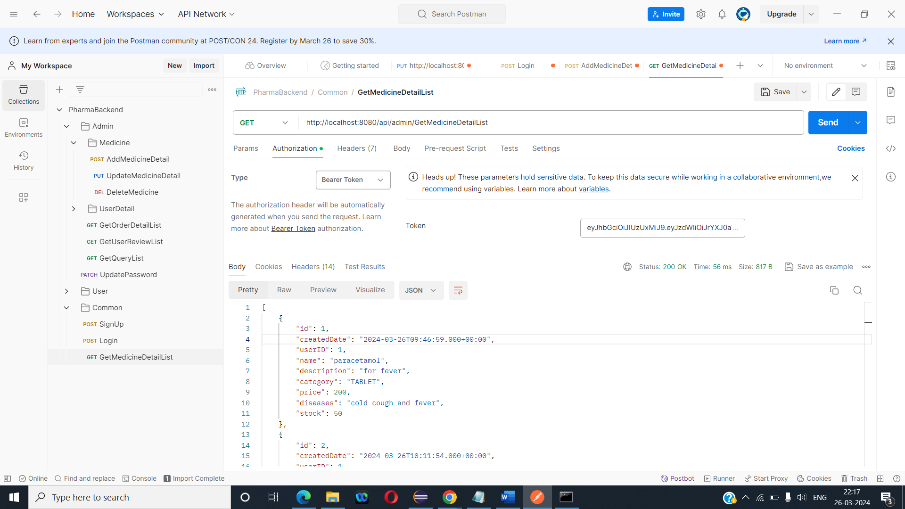

Slide 32

TESTING REPORTS

Slide 33
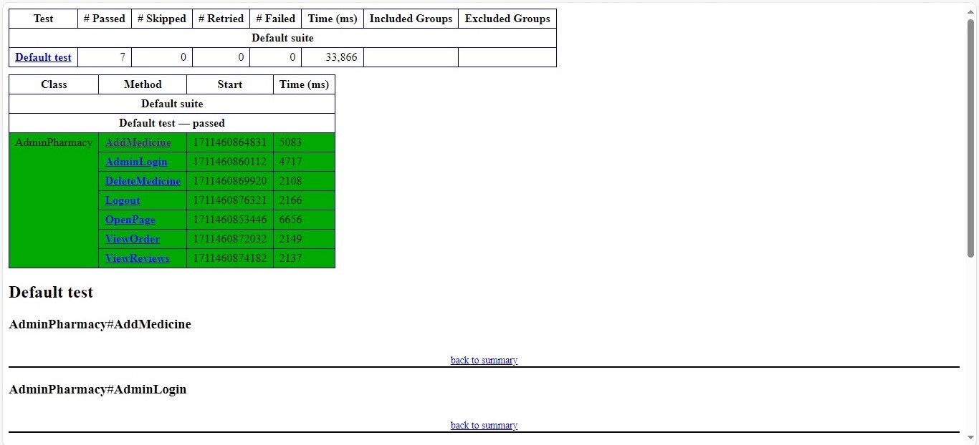
ADMIN TEST EMAILABLE REPORT
In this admin test
We have taken report from emailable-report.hmtl page to see how the test cases pass and fail.

Slide 34
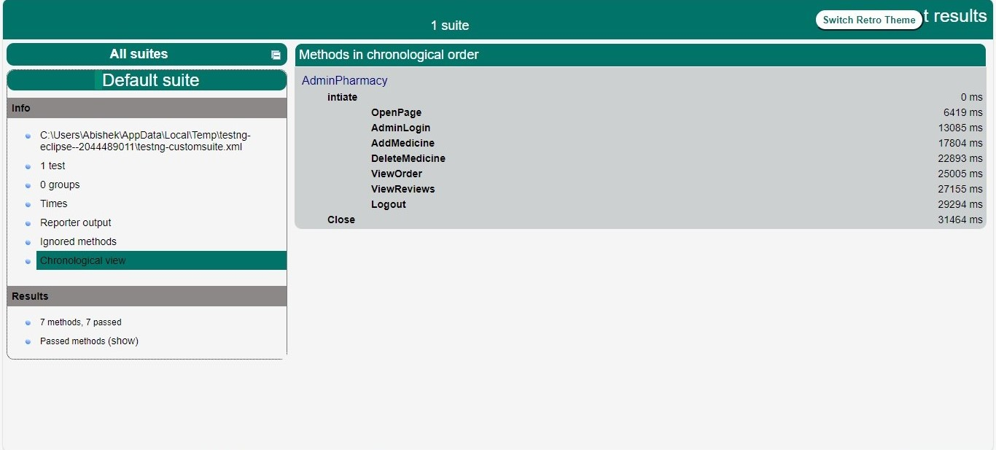
ADMIN TEST INDEX
In this admin test
We have taken report from index.hmtl page to see how the test cases pass and fail.

Slide 35
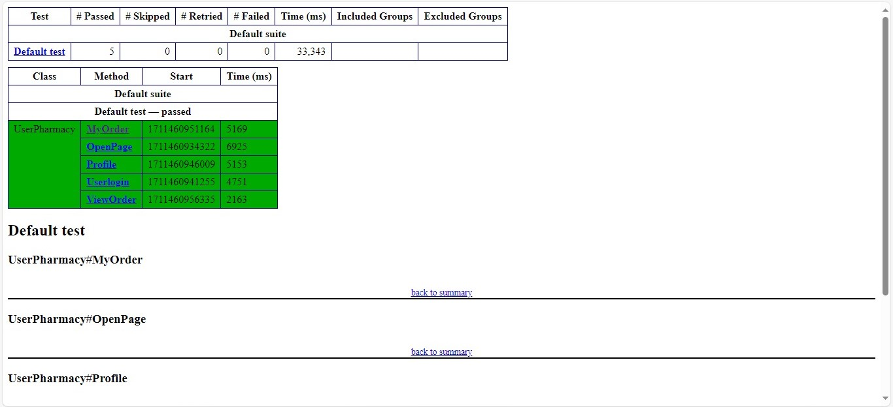
USER EMAILABLE TEST REPORT

Slide 36
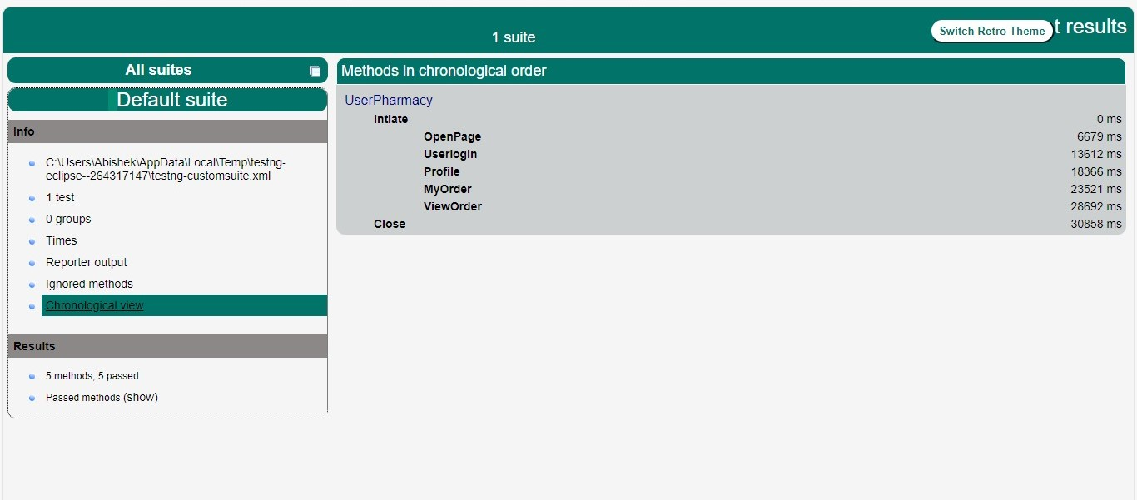
USER TEST INDEX

Slide 37
CONCLUSION
The online pharmacy provides efficient delivery, simple handling, simple ordering process, quick service with a one click and also expert by searching facilities. The benefit of using this advanced computer technology and robotic dispensing tool is greater efficiencies throughout the management process as compared to traditional pharmacies

Slide 38
THANK YOU !

